Slide 1
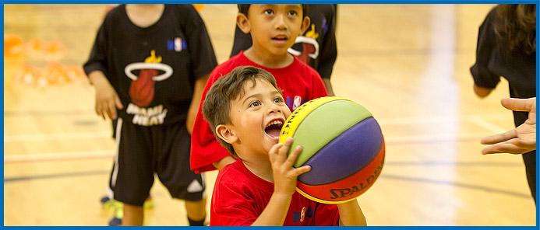
CMBA INTERMEDIATE
Fall 2024 & Winter 2025 Season
Coach Education & Development Program

Slide 2
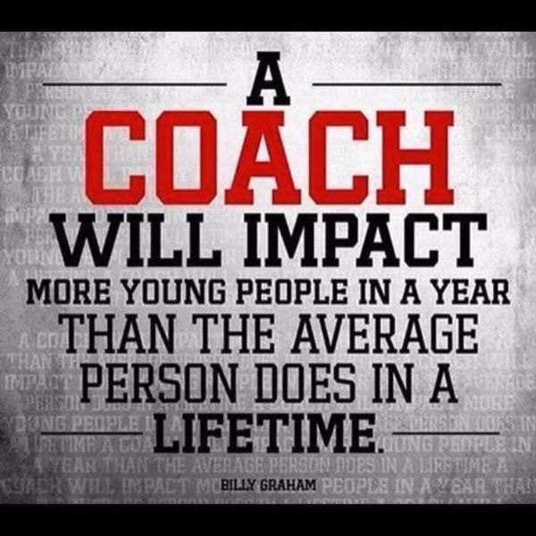
Welcome
to
CMBA Coach Education & Development

Slide 3
CMBA Coach Education & Development
is designed to
Promote Style of Play with an emphasis on Actions & Concepts
Promote Best Practices & leading Coaching Methods
Promote a Decision-Making Model for players

Slide 4
CMBA Coach Education & Development
Style of Play vs. Skill Development
Today’s trend is for Players to learn How to Play the game
Traditional Approach (Skills) vs. New Trends (Style Of Play)
Decision-Making Model is key to Team & Player Development

Slide 5
CMBA Coach Education & Development
Page 3 in INTERMEDIATE Manual
How successful is your Style of Play?
Share your Style of Play with another coach.
What would you do differently for the rest of this season?

Slide 6
CMBA Coach Education & Development
Page 4 in INTERMEDIATE Manual
CMBA Requirements
Parent Meeting (Page 7-9 in INTERMEDIATE Manual)
Expectations of INTERMEDIATE Clinic

Slide 7
CMBA Coach Education & Development Getting to Know the CMBA Website
www.cmba.ab.ca
Explode—Explore—Execute
Reporting Game Scores
Game Reports
Resources
Schedules
Links

Slide 8
Calgary Minor Basketball Association (CMBA)
Participation Agreement
Governing Conduct for All Coaches, Players and Spectators
Mission Statement - CMBA provides basketball opportunities for youth in and around Calgary that is accessible, positive, fair and safe. CMBA will also provide leadership, promoting the values of teamwork, integrity and commitment, while developing skills at all levels of competition and a lifelong love of the game.
Understanding and Abiding by the Rules is Your Responsibility
The rules of basketball should be regarded as mutual agreements, the spirit of which no one should try to evade or break. They exist for safety, proper order and enjoyment of the game for all involved
Respect Referees, Minor Officials, Coaches, and Spectators
All officials play an integral part of the game. They must be regarded as honest in intentions. Decisions of the officials must be accepted with good grace. Failure to do so may result in your removal from the gym. It may also result in a subsequent suspension.
The coach is volunteering his/her time so you/your child can enjoy basketball. Without the coach, there is no team, so be respectful and grateful for the coaches at all times.
Respectful behavior is required before, during, and after the game.
Respect the Rights, Dignity and Worth of Every Person
All persons connected with basketball are entitled to equal treatment and respect.
Respect the Facilities and Equipment Provided, Including the Gym Floor
Abuse of the facilities results in the loss of the gym for CMBA.
Guests of any player, coach, official or spectator are the responsibility of that person and must abide by the same code of conduct.
Other expected behaviors within the code of conduct:
Coaches
When you win, be respectful and gracious toward you opponent. When you lose, be congratulatory and respectful
Winning is desirable, but winning at any cost defeats the purpose of the game
When your team is well ahead, take the opportunity to try new lines, plays and skills with your players, rather than running up the score
Set a good example of sportsmanship for all children in the gym
Players
When you win, be respectful and gracious toward you opponent. When you lose, be congratulatory and respectful
Be fair always, no matter what the cost
Parents
Set a good example of sportsmanship for all children in the gym
Help make participation in CMBA a positive experience for your child and others
Applaud good plays by both team

Slide 9
CMBA Coach Education & Development Coaches Association of Canada Responsible Coaching Movement Rule of Two Background Screening Ethics Training
Notes:
What do you think about talking about the Positive Coaching Alliance? When you introduced this to me many years ago I was intrigued with this organization. I have recently looked at them for the CMBA and myself as a coach. Thoughts? https://positivecoach.org/
Mike: I don’t know enough about the PCA other than I really like their message. I’m ok to include the PCA if we actually know their materials - perhaps we should wait until CMBA adopts this program. As for the CAC, their Rule of Two and Responsible Coaching Movement are easily adaptable.

Slide 10
CMBA Coach Education & Development
White Whistle Program
To create a positive experience and gym environment for
new basketball officials.
A referee wearing a white whistle is not to be challenged before, during, and/or after games.
Remember we are all here for the kids!

Slide 11
CMBA Coach Education & Development Page 4 in INTERMEDIATE Manual Pre-game Meeting—Referee Lead Coaches / Officials / Gym Monitors / Team Captains
Do you find the Pre-Game Meeting with officials Effective?
How effective is the Gym Monitor program?
How do you run your Pre-Game meeting with your team?

Slide 12
CMBA Coach Education & Development Page 7-9 In INTERMEDIATE Manual—Canada Basketball Parent/Player Team Expectation Meeting Partner With A Coach To Discuss The 3 Questions Below
1. What key topics will you cover in your Parent/Player Meeting? 2. Would you agree that a Parent/Player meeting is valuable? 3. Is the Parent/Player Meeting required by CMBA?

Slide 13
CMBA Coach Education & Development
Pre-Game & Post-Game Meeting
What do you cover in a Pre-Game meeting?
What do you cover in a Post-Game meeting?

Slide 14
CMBA Coach Education & Development
Page 13 in INTERMEDIATE Manual
Style of Play, Actions & Concepts
What is your best Style of Play concepts/Actions?
What are the most effective Actions you used with your team?
Which Concepts do you feel are most valuable?

Slide 15
CMBA Coach Education & Development
Page 14 in INTERMEDIATE Manual
Creation of a Style of Play
Top 20 S.O.P. Points

Slide 16
CMBA Coach Education & Development
Page 15 in INTERMEDIATE Manual
Coaching Style of Play Outline
Suggested Approach
(Sequencing)

Slide 17
CMBA Coach Education & Development Page 16-17 in INTERMEDIATE Manual CMBA E3 Website
E3: Explode-Explore-Execute
CMBA E3—Execute.1—Coach Nick at Deep Game
https://sites.google.com/cmba.ab.ca/cmbacsp/execute/dribble-handoff?authuser=0
Notes:
Coach Mark should we?... instead remove Game Plan and promote the CMBA 3E Web-site of Explode, Explore, Execute https://sites.google.com/cmba.ab.ca/cmbacsp/home

Slide 18
CMBA Coach Education & Development Page 18 In INTERMEDIATE Manual Scoring the Ball Top 6 Scoring Priorities 1. Free Throws (Why are FT’s #1?) 2. Attack the Rim 3. Attack the Paint 4. 3-Point Shot from the Corner 5. 3-Point Shot from the Top 6. Mid-range Shots Coach Activity—what drills do you do to support these Top 6 Priorities?

Slide 19
CMBA Coach Education & Development Page 19 In INTERMEDIATE Manual P7R—Footwork & KPI Skill P7R is a great warm-up activity Combines Fundamental Movement Skills with Technical Skills We will do this activity on-court

Slide 20
CMBA Coach Education & Development Page 20 In INTERMEDIATE Manual Practice Planning & Season Planning How have your Practice Plans changed over time? How might you enhance your current Practice Plan? Make a list of the Skills, Actions & Concepts you want to cover this season?

Slide 21
CMBA Coach Education & Development Getting Back to Style of Play How do you promote Style of Play with your team? What drills do you do to promote Decision-making with your team/players? Block vs. Random Teaching

Slide 22
CMBA Coach Education & Development Page 23-24 In INTERMEDIATE Manual Every Practice Needs a Little TLC Share a Competitive drill with a partner. Do you Measure drills in Practice? What is the typical Tempo of your practice? Do your drills match your Style of Play? (especially shooting drills)

Slide 23
CMBA Coach Education & Development Page 25-26 In INTERMEDIATE Manual Feedback 101, 201 & 301 Feedback 101 Technical Skill Feedback Feedback 201 Feedback after the Feedback Feedback 301 Decision-making Feedback

Slide 24
CMBA Coach Education & Development Page 27-28 In INTERMEDIATE Manual KPI’s—Key Performance Indicators Starts with a Hunch Canada vs. China University of Manitoba What Hunch might you turn into a KPI?

Slide 25
CMBA Coach Education & Development Page 29-31 In INTERMEDIATE Manual Important Concepts from ESSENTIALS (Review) ABCD Teaching Phases—Loading & Unloading Measuring Drills ABCD Debrief (& Pre-brief) Global Player Development (Page 39-44 INT)

Slide 26
CMBA Coach Education & Development Page 32 In INTERMEDIATE Manual Gold Medal Model (Gold Medal Profile)

Slide 27
CMBA Coach Education & Development IPP—Individual Performance Plan Based on the Gold Medal Model IPP Excel Form How to Implement the Activity Email Mark Hogan for more information: markjonhogan@gmail.com

Slide 28
CMBA Coach Education & Development Page 33 In INTERMEDIATE Manual ROB Shot—BRAD Shot—REP’ing
ROB Range Open
Balanced
BRAD Back
Rim
And
Down
REP’ing Reminders
Encouraging
Praise

Slide 29
CMBA Coach Education & Development Page 34 in INTERMEDIATE Manual LTAD—Essentials Review

Slide 30
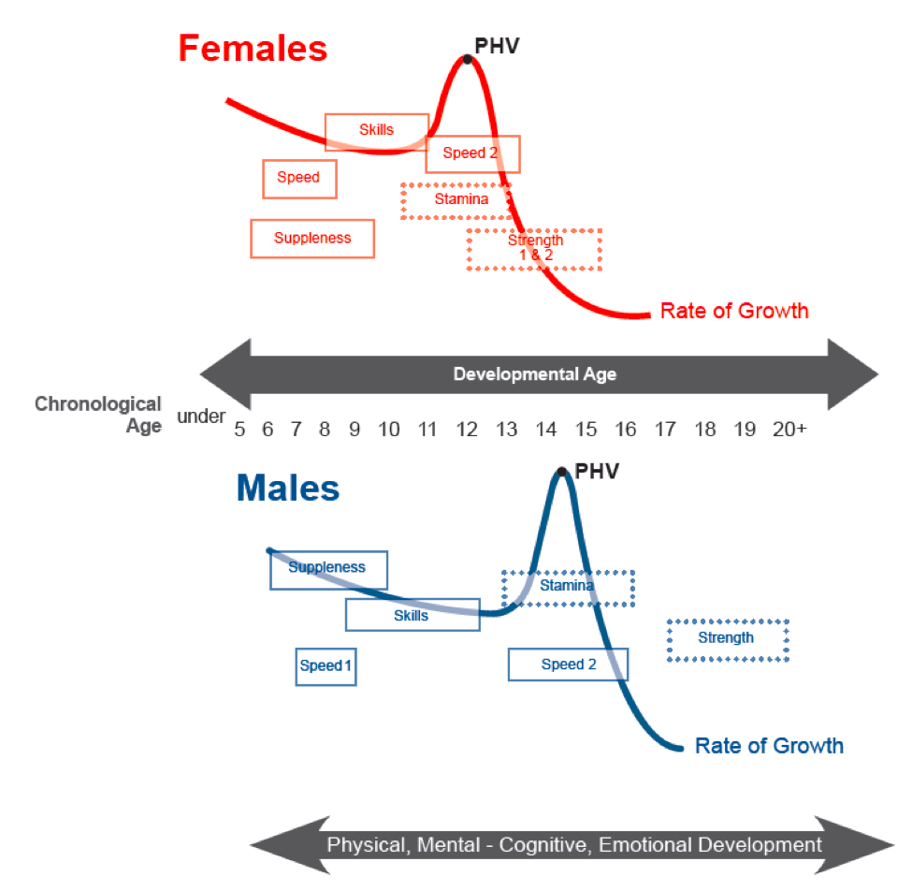
CMBA Coach Education & Development Page 35 in INTERMEDIATE Manual Peak Height Velocity

Slide 31
CMBA Coach Education & Development ESSENTIALS Review Gold Medal Model—Defensive Priorities Defend the Basket Pressure the Ball—D21 & D9 Guard 1.5 Players

Slide 32
CMBA Coach Education & Development Page 45-46 In INTERMEDIATE Manual 10 Commandments of Defense Great Handout for your players Players tend to relate to many of these defensive concepts. Which, in turn, makes defense fun to play.

Slide 33
CMBA Coach Education & Development VIDEO Read & React Basketball—Rick Torbett St. Joseph’s College of Maine Video (Part I of 2 Part Series - CMBA website)
Click Here

Slide 34
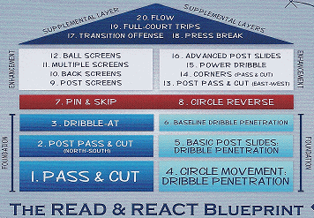
CMBA Coach Education & Development Page 36-37 In INTERMEDIATE Manual Read & React Basketball—Rick Torbett Read & React—20 Layers for Youth Basketball
228 Page Read & React Document

Slide 35
CMBA Coach Education & Development See Video Read & React Basketball—Rick Torbett Circle Movement Video

Slide 36
CMBA Coach Education & Development Prep for the On-court Session
Be Prepared To Participate On-court… As with Players, Coaches Learn Better via Experiential Learning… Competency Based Coaching is the New Standard for NCCP… We have an Outline to Follow, Unless… Bring Your Questions! We will Spend More Time on Style Of Play than on Individual Skill Development… Offense takes Longer to Teach than Defense so We’ll do more Offense… Emphasis: Establishing Style of Play, Actions & Concepts | Read & React Offense… Scrimmage (D Phase) vs. Breakdown Drills (ABC Phase) | Training Ugly Works!

Slide 37
CMBA Coach Education & Development BONUS Materials Style of Play Review

Slide 38
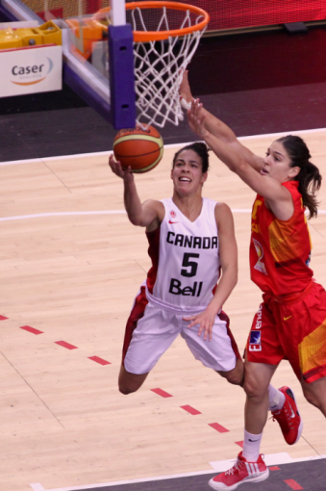
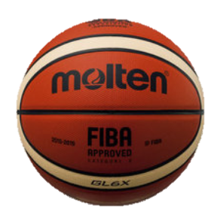
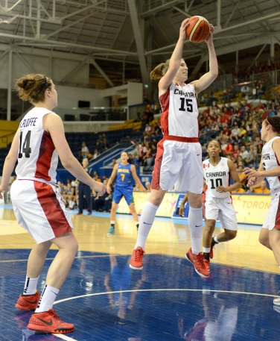
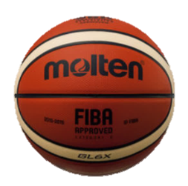
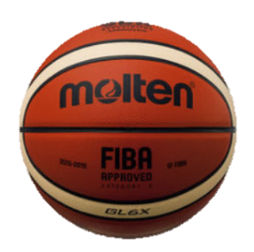
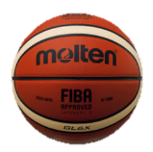
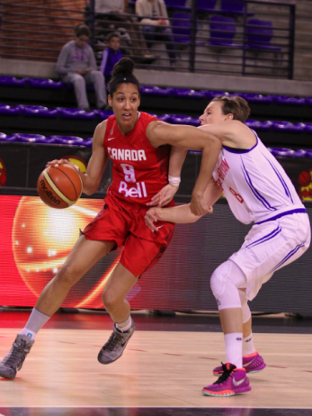
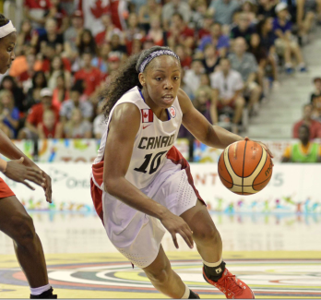
CMBA Coach Education & Development Measuring Success—The Four Factors
Score
the
ball
Rebound
the
ball
20%
40%
Control
the
ball
Fouls
25%
15%

Slide 39
CMBA Coach Education & Development BONUS Materials LTAD—Long Term Athlete Development 5 S’s of LTAD Skills Speed Stamina Strength Suppleness Not only are you developing Basketball Players, you are also developing Athletes!

Slide 40
CMBA Coach Education & Development BONUS Materials Shot Clock Phases Best teams in the world shoot early shot clock shots 6 Seconds – 12 Seconds – 6 Seconds 8 Seconds – 8 Seconds – 8 Seconds Explode/Explore—Execute / Danger Zone Players—Coach—Players Danger Zone is Late in the Shot Clock—last 6 seconds CB Moved 6 Shots From Late Clock To Early Clock After 2012

Slide 41
CMBA Coach Education & Development BONUS Materials Actions & Dominoes
Actions
Actions & Dominoes Actions are to Create Advantages Small Advantages to become Big Advantages Neutral may become an Advantage or a Disadvantage One Action leads to another Action which leads to Another Action Multiple Actions are Often Required until the Defense Falls (Dominoes)

Slide 42
CMBA Coach Education & Development BONUS Materials Establishing FLOW 1-2-3-4-5 1 = run our regular Actions 2 = get the ball to the 2nd side 3 = set more Screens/picks (2 letter e’s in three & screen) 4 = 4 Down quick hit 5 = Rhymes with Drive

Slide 43
CMBA Coach Education & Development Page 22 In INTERMEDIATE Manual PVAD—Position, Vision, Anticipation, Decision-making
Positioning improves
Vision which improves
Anticipation which improves
Decision-making

