Slide 1
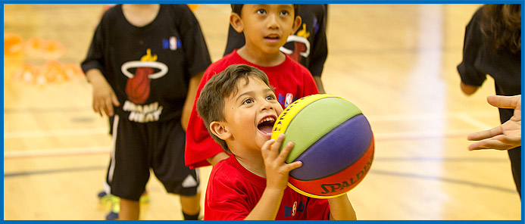

AdVANCED
Fall 2024 - Winter 2025 Season
Coach Education & Development Program

Slide 2
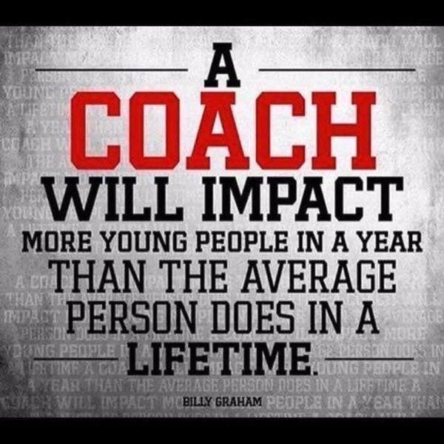
Welcome
to
CMBA Coach Education & Development

Slide 3
CMBA Coach Education & Development
is designed to
Promote Style of Play with an emphasis on Actions & Concepts
Promote Best Practices & leading Coaching Methods
Promote a Decision-Making Model for players
CMBA Website Review

Slide 4
CMBA Coach Education & Development
Page 3 in Advanced Manual
How successful was your Style of Play last season?
Share your Style of Play with another coach.
What would you do differently this coming season?

Slide 5
CMBA Coach Education & Development
Page 5 in Advanced Manual
CMBA Website
CMBA Website Review
Game Report
Reporting Scores
Coach Info/Education
Participation Agreement
Explode—Explore—Execute

Slide 6
CMBA Coach Education & Development
CMBA E3 Materials
DHO—Compare & Contrast Coaching Techniques
CMBA E3—Execute.1—Coach Nick
CMBA E3—Execute.2—Coach Brianna Finch

Slide 7
CMBA Coach Education & Development
VIDEO
Read & React Basketball—Rick Torbett
Saint Joseph’s College of Maine Video
(Part 2 - CMBA Website)

Slide 8
CMBA Coach Education & Development
Page 7-13 in ADVANCED Manual
REVIEW
Essentials & Intermediate Review
ABCD Teaching Phases
ABCD Debrief & Pre-brief
TLC (Teaching Learning Competition)
Creation of a Style of Play & Outline
Gold Medal Model
Read & React (20 Layers)

Slide 9
CMBA Coach Education & Development
Page 7-13 in ADVANCED Manual
REVIEW
Essentials & Intermediate Review
KPI’s (Canada vs China & U of M)
Explode—Explore—Execute (Do you use it?)
Measuring Drills (Do you do it?)
Scoring Priorities (Top 4 Essentials / Top 6 Intermediate)

Slide 10

CMBA Coach Education & Development
White Whistle Program
To create a positive experience and gym environment for
new basketball officials.
A referee wearing a white whistle is not to be challenged before, during, and/or after games.
Remember we are all here for the kids!

Slide 11
CMBA Coach Education & Development
Page 14 in ADVANCED Manual
Actions, Style of Play & Coaching Concepts
Single Gap Actions
Double Gap Actions
Wave Actions

Slide 12
CMBA Coach Education & Development
Page 15-16 in ADVANCED Manual
E3 Article
EXPLODE
Pace & Speed / Rebound & Go
EXPLORE
Scan Immediately & Pass to Open Teammate
EXECUTE
If there is no Fast Break Opportunity, Execute Actions

Slide 13
CMBA Coach Education & Development
Review
Gold Medal Model (Gold Medal Profile)

Slide 14
CMBA Coach Education & Development
Page 17 in ADVANCED Manual
Gold Medal Profile—Offensive Priorities
Top 6 Scoring Priorities / Shot Spectrum
Attack the Rim
Attack the Paint
Free Throws
3-Point Shot from the Corner
3-Point Shot from the Top
Mid-Range Shot

Slide 15
CMBA Coach Education & Development
Page 18 in ADVANCED Manual
P7R Footwork
Have a Plan when Attacking the Paint
P7R is the Plan

Slide 16
CMBA Coach Education & Development
Page 19 In ADVANCED Manual
Gold Medal Model—Defensive Priorities
Defend the Basket
Pressure the Ball—D21 & D9
Guard 1.5 Players

Slide 17
CMBA Coach Education & Development
Page 20 In ADVANCED Manual
Gold Medal Model—Defensive Priorities

Slide 18
CMBA Coach Education & Development
Page 21-22 In ADVANCED Manual
10 Commandments of Defense
Great Handout for your players
Players tend to relate to many of these defensive concepts.
Which, in turn, makes defense fun to play.

Slide 19
CMBA Coach Education & Development
Page 21-22 In ADVANCED Manual
10 Commandments of Defense
Which of the 10 Commandments resonate with you?
Which of the 10 Commandments do you currently use.
Solving problems (no. 10)
1. Preventer
2. Fixer
3. Eraser
How would you apply this Commandment to your team’s defense?

Slide 20
CMBA Coach Education & Development
Page 23 in ADVANCED Manual
Hot Spot Rebounding
Hot Spot
Short Spot
Clean-up
Short Safety
Long safety

Slide 21
CMBA Coach Education & Development
Page 24-25 In ADVANCED Manual
Feedback 101, 201 & 301
Feedback 101
Technical Skill Feedback
Feedback 201
Feedback after the Feedback
Feedback 301
Decision-making Feedback

Slide 22
CMBA Coach Education & Development
Page 26 in ADVANCED Manual
Retrieval Techniques
Timing is important…
Use this technique every practice…
Critical to players’ growth…

Slide 23
CMBA Coach Education & Development
Page 27 in ADVANCED Manual
Bloom’s Taxonomy
Remember
Understand
Apply
Analyze
Evaluate
Create

Slide 24
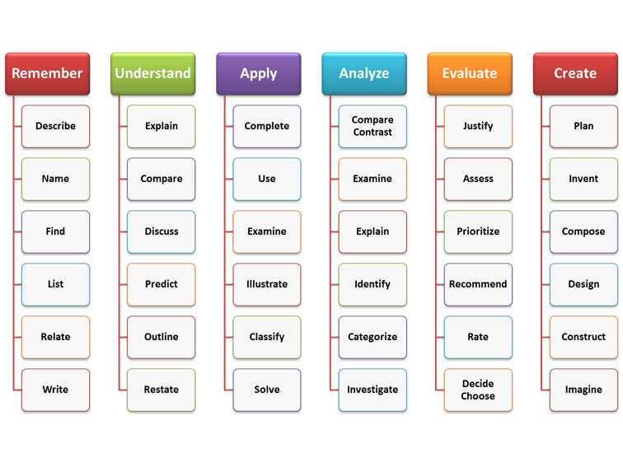
BLOOM’s TAXONOMY – Teaching & Learning Progression
Page 27 In ADVANCED Manual

Slide 25
CMBA Coach Education & Development
Page 28 In ADVANCED Manual
LTAD—Long Term Athlete Development
5 S’s of LTAD
Skills
Speed
Stamina
Strength
Suppleness
Not only are you developing Basketball Players, you are also developing Athletes!

Slide 26
CMBA Coach Education & Development
Page 29 In ADVANCED Manual
Peak Height Velocity

Slide 27
CMBA Coach Education & Development
Page 30 In ADVANCED Manual
Actions & Dominoes | Creating Advantages
Advantages
Actions & Dominoes
Actions are to Create Advantages
Small Advantages to become Big Advantages
Neutral may become an Advantage or a Disadvantage
One Action leads to another Action which leads to Another Action
Multiple Actions are Often Required until the Defense Falls (Dominoes)

Slide 28
CMBA Coach Education & Development
Page 31 In ADVANCED Manual
Quick Hits
Phoenix (Wave Action)
Shooter (3 Point Action)
Curry (Regular, Big, Special, Hammer)
Hammer Screens (see video)
Fist (Post-up Action)
GDP (3 Player Action—Wave Action)
Combo (3 Player Action—Wave Action)

Slide 29
CMBA Coach Education & Development
Page 32 In ADVANCED Manual
Special Situations (Special Situation Clinic)
BLOBs
SLOBs
Jump Ball
ATO’s
Quarter Change-ups
Shot Clock
1-2-3-4-5 (next slide)
10 Series
2 Series

Slide 30
CMBA Coach Education & Development
Establishing FLOW
1-2-3-4-5
1 = run our regular Actions
2 = get the ball to the 2nd side
3 = set more Screens/picks (2 letter e’s in three & screen)
4 = 4 Down quick hit
5 = Rhymes with Drive

Slide 31
CMBA Coach Education & Development
Page 33 In ADVANCED Manual
Shot Clock Phases
Best teams in the world take early shots in the shot clock
6 Seconds – 12 Seconds – 6 Seconds
8 Seconds – 8 Seconds – 8 Seconds
Explode/Explore—Execute / Danger Zone
Players—Coach—Players
Danger Zone is Late in the Shot Clock—last 6 seconds
CB Moved 6 Shots From Late Clock To Early Clock After 2012

Slide 32
CMBA Coach Education & Development
Page 34 In ADVANCED Manual
Zone Offence Principles
Fast Break
Line up in the Gaps
Attack the Seams
Overload one side of the Floor
Flatten the Zone
Pull out the low Defender
Ball Reversal (Cross Main Street)
Penetration & Pass-Pass
Attack Heart of the Defence
Ball Movement

Slide 33
CMBA Coach Education & Development
Page 35-41 In ADVANCED Manual
Zone Thoughts by Mike MacKay
Keep it Simple (KISS Principle)
Actions & Concepts
Less is More!

Slide 34
CMBA Coach Education & Development
Page 42-47 In ADVANCED Manual
Developing the Positionless Play
Global Player Approach
Nikola Jokić Article

Slide 35
CMBA Coach Education & Development
Prep for the On-court Session
Be Prepared To Participate On-court…and Bring your Child & a Friend/Teammate
As with Players, Coaches Learn Better via Experiential Learning…
Competency Based Coaching is the New Standard for NCCP…
Bring Your Questions & Bring a Basketball…
We will Spend More Time on Style Of Play than on Individual Skill Development…
Offense takes Longer to Teach than Defense so We’ll do more Offense…
Emphasis: Establishing Style of Play, Actions & Concepts | Read & React Offense…
Breakdown Drills (ABC Phase) & Scrimmage (D Phase) | Training Ugly Works!

Slide 36
CMBA Coach Education & Development
BONUS Materials
BONUS
Materials

Slide 37
CMBA Coach Education & Development
Coaches Association of Canada
Responsible Coaching Movement
Rule of Two
Background Screening
Ethics Training

Slide 38
CMBA Coach Education & Development
IPP—Individual Performance Plan
Based on the Gold Medal Model
IPP Excel Form
80 Performance Criteria
How to Implement the Activity
Planning Your Trip—Milestones
Email Mark Hogan for more information: markjonhogan@gmail.com

Slide 39
CMBA Coach Education & Development
Measure Your Drills | Analytics
What gets measured gets done!
What can you measure?
The best teams have a tracking method
You can track practices or you can track games
You can track individual performances or team performances

Slide 40
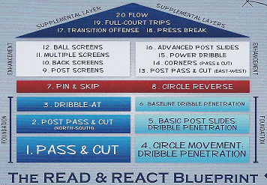
CMBA Coach Education & Development
Read & React Basketball—Rick Torbett
Read & React—20 Layers for Youth Basketball
228 Page Read & React Document
Click Here

Slide 41
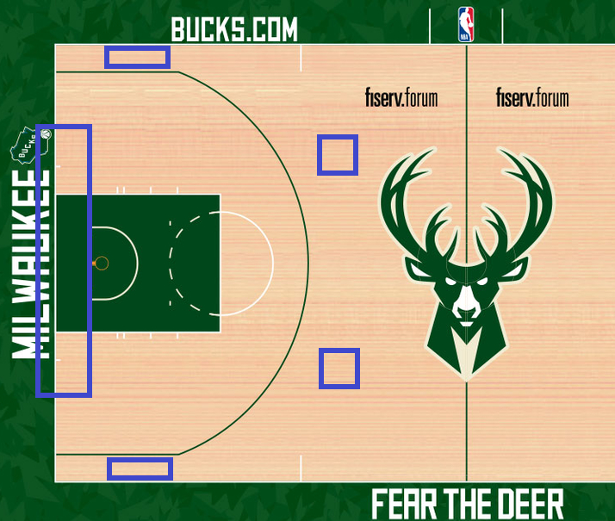
CMBA Coach Education & Development
Good Offense Starts with Good Spacing
SPACING—a vital Concept

Slide 42
CMBA Coach Education & Development
Read & React Basketball—Rick Torbett
Circle Movement Review
Girls Practice.1
Boys Practice.2
Watch Videos and provide a Critical Review

Slide 43
CMBA Coach Education & Development
Stages vs. Ages
Stage vs. Age
Loading & Unloading
Who + Why = What + How
Context, Context, Context

Slide 44
CMBA Coach Education & Development
PVAD—Position, Vision, Anticipation, Decision-making
P ositioning improves
V ision which improves
A nticipation which improves
D ecision-making

Slide 45
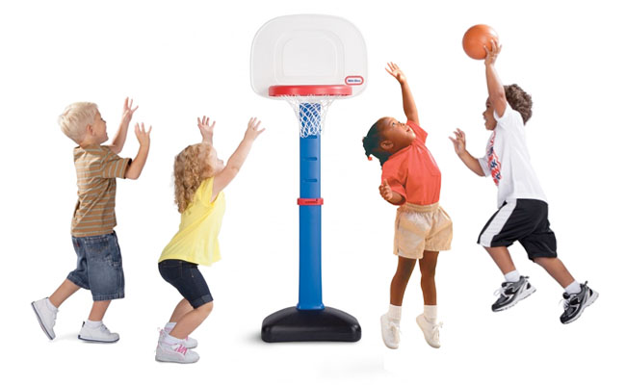
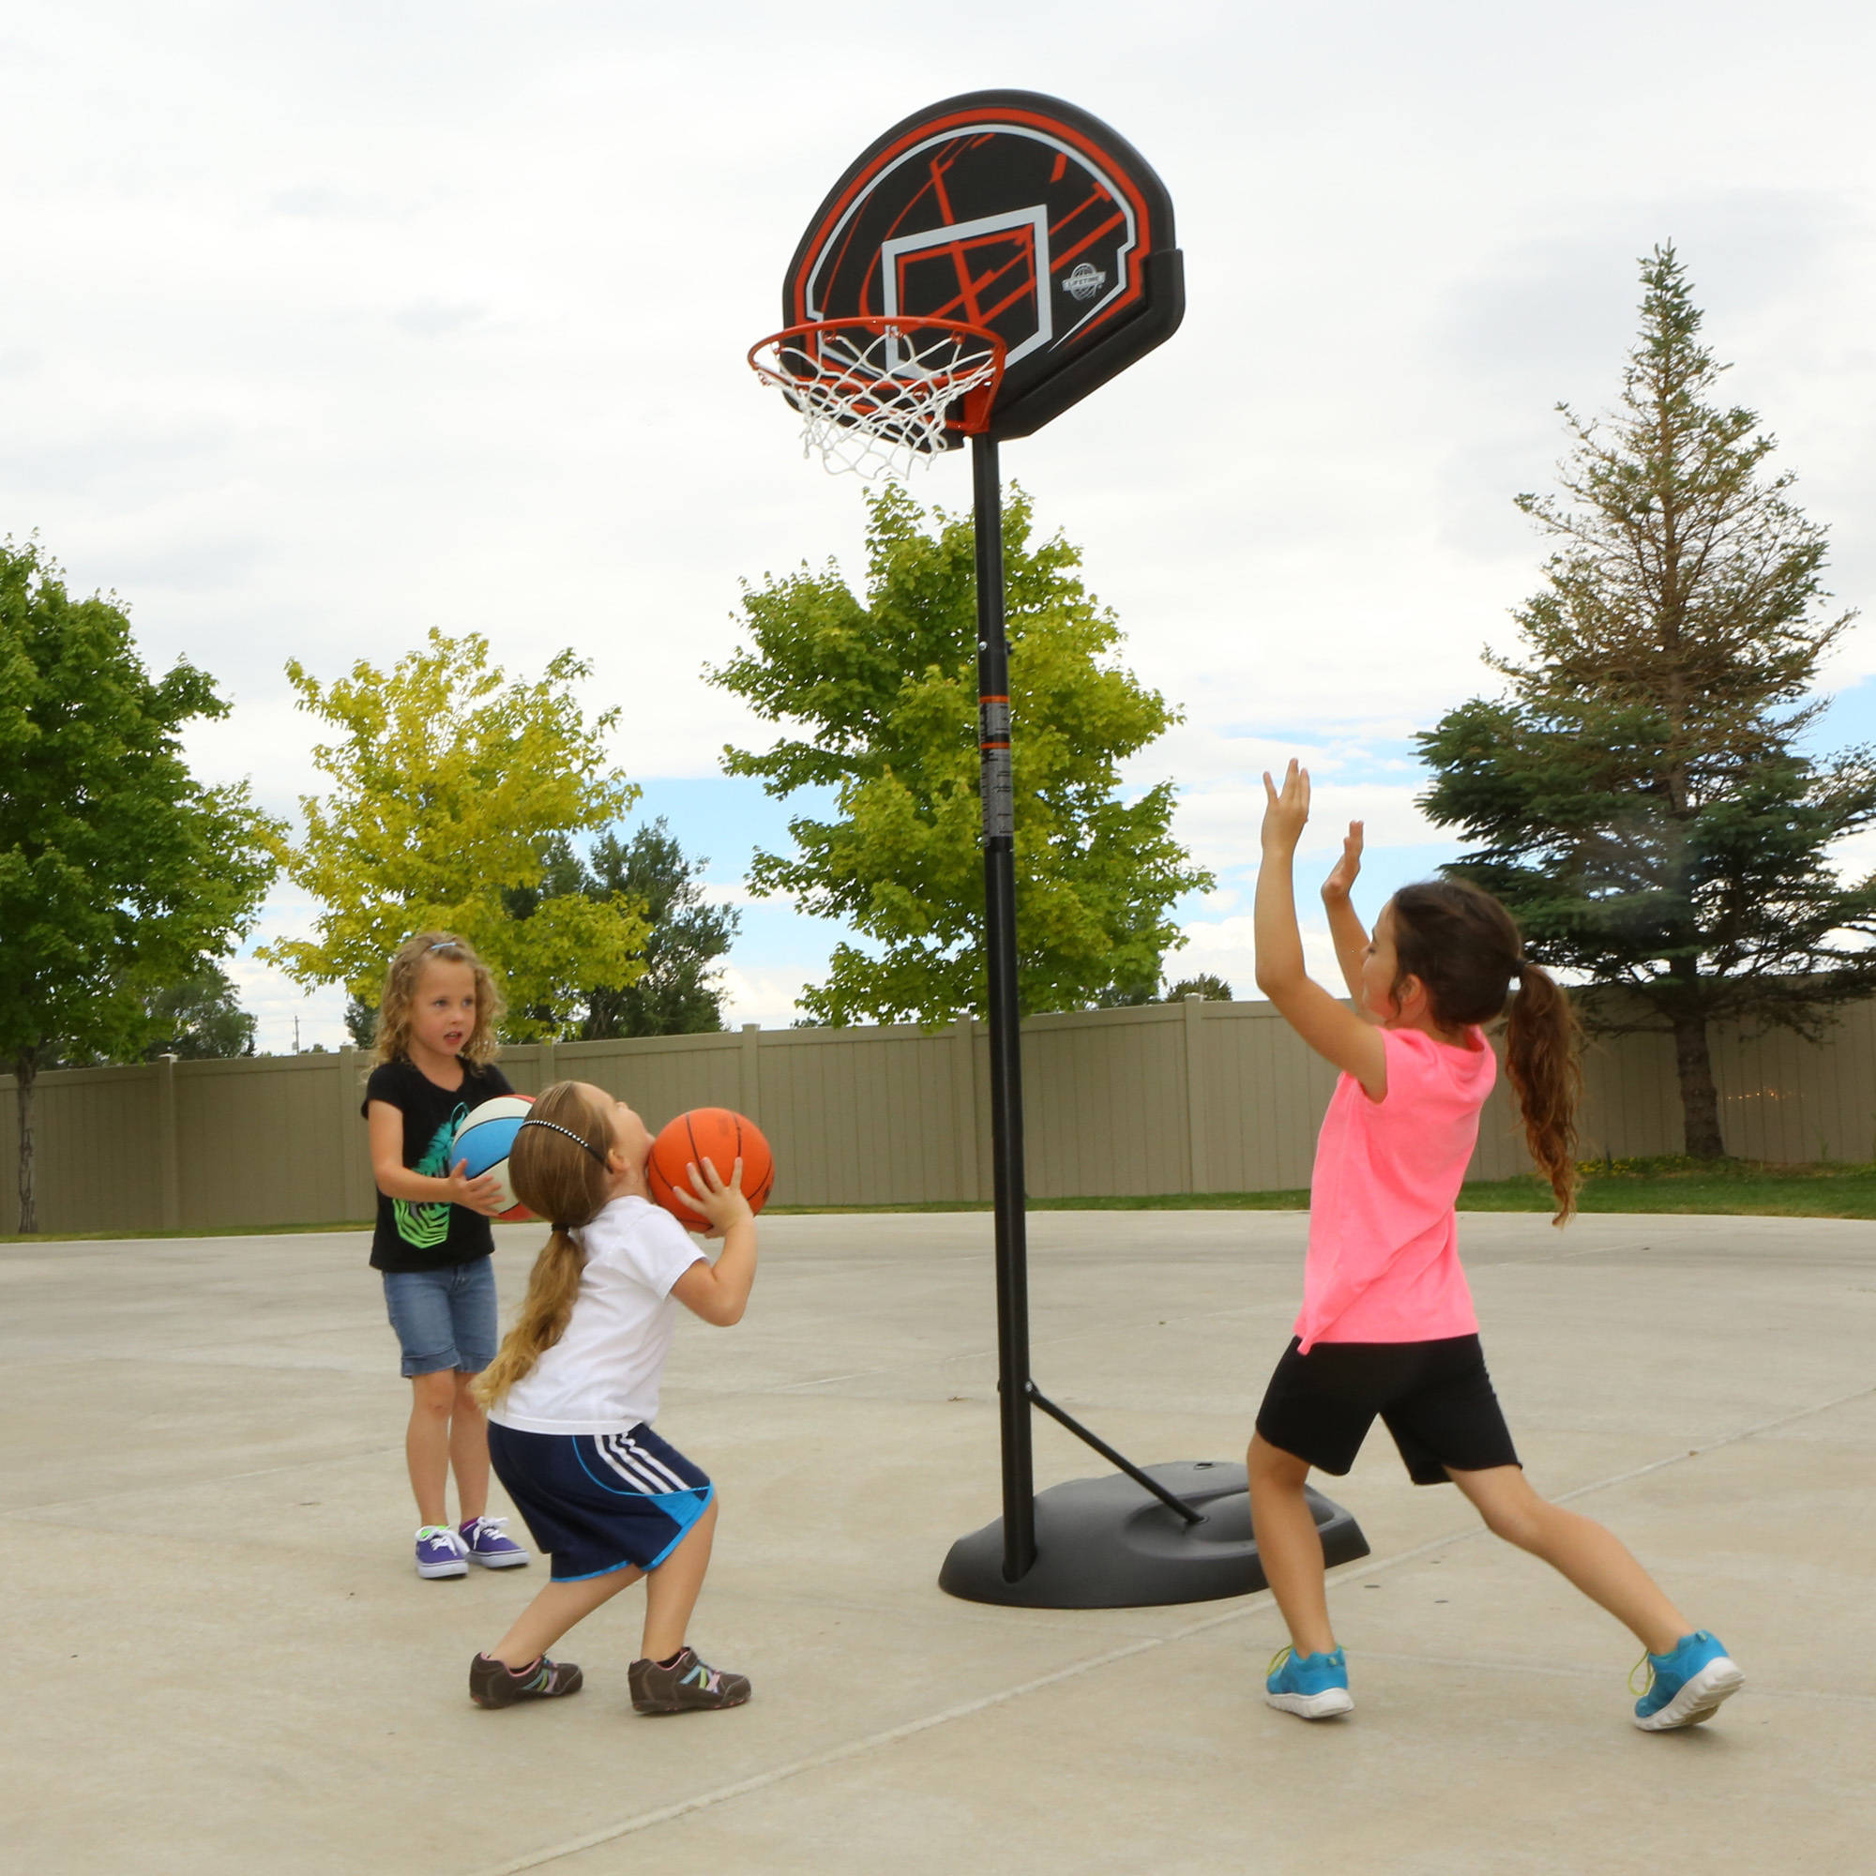
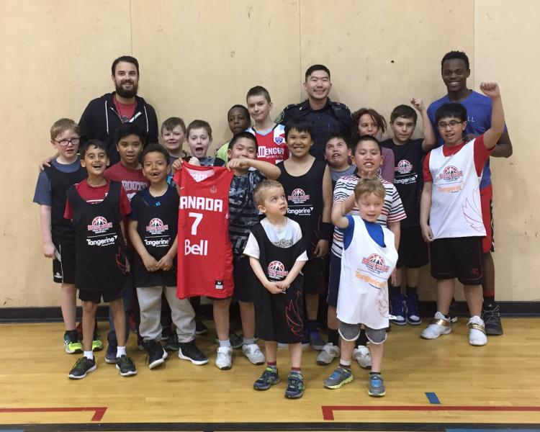

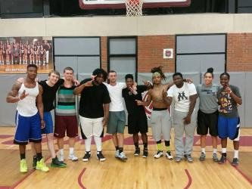
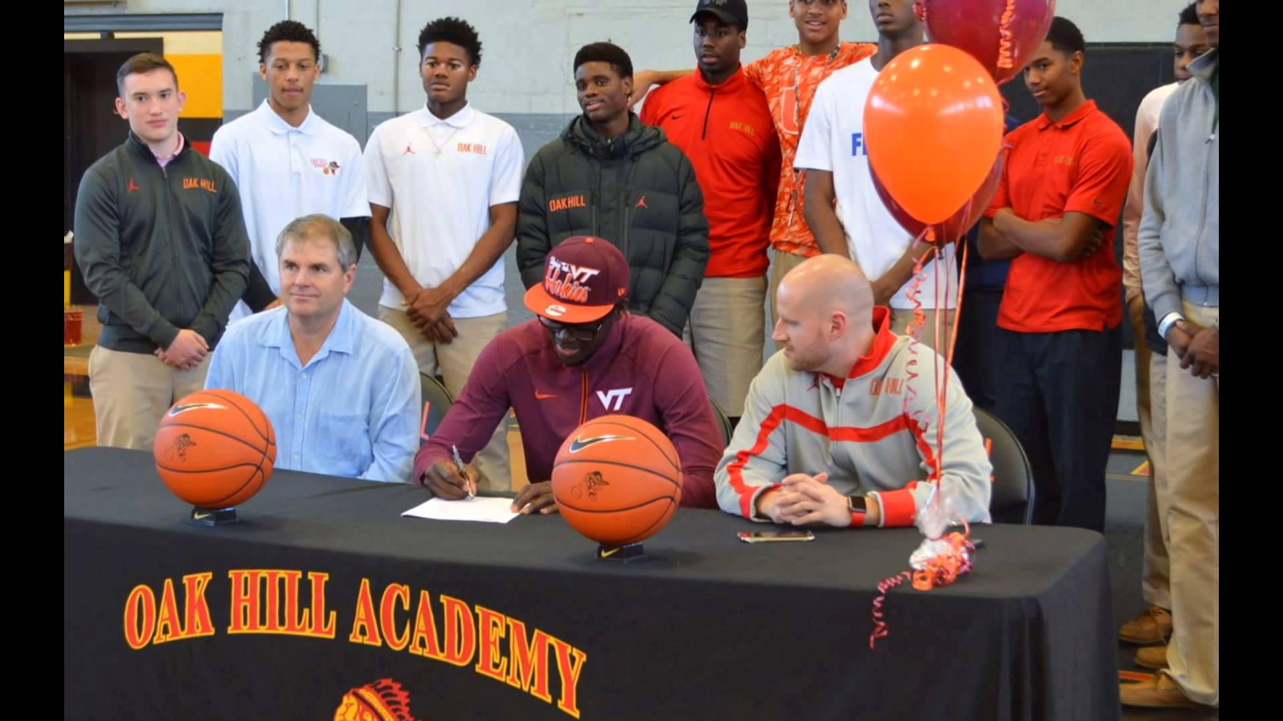
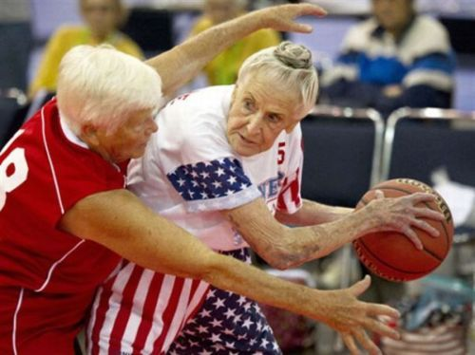
Context: Stage vs. Age
BONUS Materials
Context
Who + Why = What + How

Slide 46
CMBA Coach Education & Development
Coach Gold Medal Model
Quality Coach
Developing Winners Who Can Perform in the Demands of the Storm
N
Environment
- Culture and DTE
Connections
Individual
Know your athletes
Establish anchors
Grow and amplify
Individual
Team
W
Dreams
E
Confidence
- Balance
- It all comes together
- Completely synchronized
IPPs
TPP
Team
Style of play based on strengths
Task cohesion
Social cohesion
Dreams
Passion
Plan
In it for the long-term
S

Slide 47
Shared Leadership Approach – Connections

