Slide 1
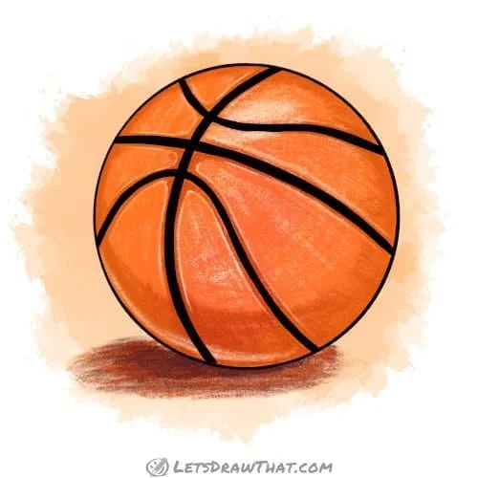
‘Style of Play’ Coach Education
Establishing Style of Play
Concepts, Actions & Decision-Making
Mark Hogan, ChPC Chartered Professional Coach

Slide 2
Explode—Explore—Execute
(Canada Basketball Article)
Pace
B1-E2-C4
Single Gap Actions
Double Gap Actions
Decision Making Model

Slide 3
Style of Play Coach Education
Actions
vs.
Quick Hitters
&
Set Plays

Slide 4
What is an ACTION?
Example: Pick & Roll Pass & Cut (Give & Go)
Post Play
Dribble Hand-off (DHO)
Wave Actions—concurrent Actions (GDP)
ACTIONS & DOMINOES

Slide 5
ACTIONS & DOMINOES
Single Gap Actions & Double Gap Actions
Actions create offensive Advantages - Small Advantages to Big Advantages - Neutral requires an Action to get to gain an Advantage
- Actions are designed to fell the Defense (Dominoes to Fall)
Wave Actions designed to create Advantages - once Defense scrambles (Dominoes Fall), Advantages result

Slide 6
POSITIONS & SPACING
Six (6) Perimeter Positions
Use of Single Gaps & Double Gaps
Five (5) Out Offensive Spacing to Execute

Slide 7
Style of Play Coach Education Good Offense Starts with Good Spacing SPACING—a vital Concept

Slide 8
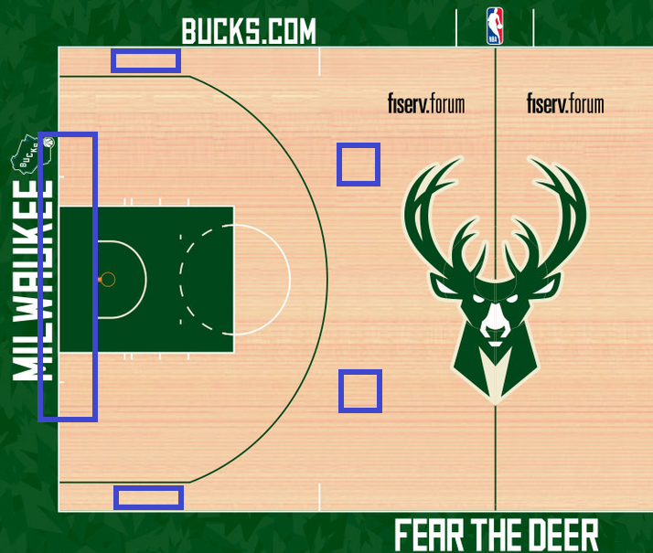
Style of Play Coach Education Good Offense Starts with Good Spacing SPACING—a vital Concept

Slide 9
Concepts – Actions – Decisions

Slide 10
Good to Great Shots
Shot Spectrum / Shot Priorities (after 2012)
Attack the Rim
3 Point Shot
Free Throw
Mid-Range Shot

Slide 11
Good to Great Shots
Shot Spectrum / Shot Priorities (after 2016)
Attack the Rim
Attack the Paint
Free Throw
3 Point Shot from Corner
3 Point Shot from Top
Mid-Range Shot

Slide 12
Two Types of Shots
ROB Shot (Decision)
Range
Open
Balanced
BRAD Shot (Technical)
Back
Rim
And
Down

Slide 13
Explode
(Immediately)
Pace (FB)
Rebound & Go
Rebounder Dribbles (B1)
Attack the Alley (Spacing & Seams)
Pass Up-court to an Open Teammate (E2)
Non-rebounders are to Explode & Create Actions
Rim Runner, Corner Three, Trail Three, Trail Drive, etc…,
Bounce Baseline, Slash to Hoop/Duck-in, Create Double Gaps,
Recognize Single Gaps, Screen/Pick for a Teammate, CHOICES…

Slide 14
Explore
(up to 6 seconds)
Read the Defense
What is the Best Early Shot?
Players to Make Explore Decisions
Players to Communicate Available Actions
Provide Reminders that Reinforce Action Choices

Slide 15
Execute
(next 12 seconds—avoid the Danger Zone—last 6 seconds)
Single Gap Actions - Pass & Cut, Pass & Pick, Pass & Slip, Gets, Dribble-At,
Dribble-At to Post-up, Dribble-At Post-up to Laker Cut,
/ Replace, Dribble-At to Draft Drive, Ball Screen (Pick),…
Double Gap Actions - Attack the Rim, Dribble Hand-off (DHO), DHO Slip,
DHO Pick, Combo, Pass-Cut-Pause-Fill,…
KPI’s (non-traditional stats) - Key Performance Indicators (KPI), Ball Reversal,
Post-up (U of M), Attack Rim/Key, Two Foot Stop,…
2nd Side Series - Reverse Ball to 2nd Side (Why?), 2nd Side + Post Play (Why?)
Verbal Cues: 2 = ___ / 2.3 = ___ / 2.4 = ___ / 2.5 = ___
Provide Reminders that Reinforce Action Choices

Slide 16
Single Gap Actions

Slide 17
Single Gap Actions

Slide 18
Single Gap Actions

Slide 19
Single Gap Actions

Slide 20
Execute
(next 12 seconds—avoid the Danger Zone—last 6 seconds)
Single Gap Actions - Pass & Cut, Pass & Pick, Pass & Slip, Gets, Dribble At,
Dribble At to Post-up, Dribble At Post-up to Laker Cut,
Dribble At to Draft Drive, Live Ball Screen (Pick),…
Double Gap Actions - Attack the Rim, Dribble Hand-off (DHO), DHO Slip,
DHO Pick, Combo, Pass-Cut-Pause-Fill,…
KPI’s (non-traditional stats) - Key Performance Indicators (KPI), Ball Reversal,
Post-up (U of M), Attack Rim/Key, Two Foot Stop,…
2nd Side Series - Reverse Ball to 2nd Side (Why?), 2nd Side + Post Play (Why?)
Verbal Cues: 2 = ___ / 2.3 = ___ / 2.4 = ___ / 2.5 = ___
Provide Reminders that Reinforce Action Choices

Slide 21
Style of Play Coach Education
Pass—Cut—Fill
(old approach)
Pass, Cut, Pause, Fill
(new approach—Why?)

Slide 22
Double Gap Actions

Slide 23
Execute
(next 12 seconds—avoid the Danger Zone—last 6 seconds)
Single Gap Actions - Pass & Cut, Pass & Pick, Pass & Slip, Gets, Dribble At,
Dribble At to Post-up, Dribble At Post-up to Laker Cut,
Dribble At to Draft Drive, Live Ball Screen (Pick),…
Double Gap Actions - Attack the Rim, Dribble Hand-off (DHO), DHO Slip,
DHO Pick, Combo, Pass-Cut-Pause-Fill,…
KPI’s (non-traditional stats) - Key Performance Indicators, Ball Reversal,
Post-up (U of M), Attack Rim/Key, Two Foot Stop,…
2nd Side Series - Reverse Ball to 2nd Side (Why?), 2nd Side + Post Play (Why?)
Verbal Cues: 2 = ___ / 2.3 = ___ / 2.4 = ___ / 2.5 = ___
Provide Reminders that Reinforce Action Choices

Slide 24
KPI’s – Key Performance Indicators
KPI Starts with a Hunch
Attacking the Key | One Foot Take-off vs. Two Foot Stop
Canada vs. China Series 2016
2nd Side & Inside Efficiency | KPI Statistics (U of M practice)
Create your own Hunch for a KPI to improve your game!

Slide 25
Execute
(next 12 seconds—avoid the Danger Zone—last 6 seconds)
Single Gap Actions - Pass & Cut, Pass & Pick, Pass & Slip, Gets, Dribble At,
Dribble At to Post-up, Dribble At Post-up to Laker Cut,
Dribble At to Draft Drive, Live Ball Screen (Pick),…
Double Gap Actions - Attack the Rim, Dribble Hand-off (DHO), DHO Slip,
DHO Pick, Combo, Pass-Cut-Pause-Fill,…
KPI’s (non-traditional stats) - Key Performance Indicators (KPI), Ball Reversal,
Paint Touch (U of M), Attack Rim/Key, Two Foot Stop,…
2nd Side Series - Reverse Ball to 2nd Side (KPI), 2nd Side + Paint Touch (KPI)
Verbal Cues: 2 = ___ / 2.3 = ___ / 2.4 = ___ / 2.5 = ___
Provide Cues/Reminders to Reinforce Actions

Slide 26
2nd Side Series (KPI)
Verbal Cue: 2.0 = Reverse Ball
2.3 = Reverse Ball + Screen 2.4 = Reverse Ball + 4 Down
2.5 = Reverse Ball + Drive

Slide 28
Decision Making / Bball IQ Technique
ABCD Debrief
ABCD Teaching Phases
Practice the Way you Play—D Phase
Train Ugly
It Happens in D Phase
Suggestions vs. Requirements
Non-negotiables

Slide 29
ABCD Debrief
A Agree—What worked well?
- has to be something positive…
B Build—teammates discuss A
- most often Why did something go well?
C Challenge—What went wrong?
- What needs to be corrected &/or How to Fix it!
D Deeper—usually for the coach

Slide 30
Pre-brief Technique
Once players become accustomed to debriefs, the next step is to incorporate pre-briefs…
Before each D Phase, allow players time to determine which Action(s) they want to execute…
Debriefs & Pre-briefs are arguably the number one decision-making tools coaches can utilize to enhance player development & effectiveness…

Slide 31
Decision Making Technique
ABCD Debrief
ABCD Teaching Phases
Practice the Way you Play—D Phase
Train Ugly
It Happens in D Phase
Suggestions vs. Requirements
Non-negotiables

Slide 32
ABCD Teaching Phases
Practice the Way you Play—D Phase
A Phase On Air—No Defense
B Phase Guided Defense
C Phase Live Breakdowns
D Phase 5on5 / Game-like Play
- Let play go for duration / do not interrupt
- Train Ugly / Manage the Chaos

Slide 33
Decision Making Technique
ABCD Debrief
ABCD Teaching Phases
Practice the Way you Play—D Phase
Train Ugly
It Happens in D Phase
Suggestions vs. Requirements
Non-negotiables

Slide 34
Decision Making Technique
ABCD Debrief
ABCD Teaching Phases
Practice the Way you Play—D Phase
Train Ugly
It Happens in D Phase
Suggestions vs. Requirements
Non-negotiables

Slide 35
Two Coaching Approaches
Random &
Block

Slide 36
FEEDBACK
101 | 201 | 301
Technical Skill Specific Feedback
What Happens after the Feedback
Decision-making & Problem-solving Feedback
The Coach’s Guide to Teaching
- Doug Lemov

Slide 37
Technical Skill Specific
101
Focused Feedback
Use Stoppages & Apply
Feedback then Apply (speed)
Economy of Language—Less is More
Distinguish the Person from the Action

Slide 38
What Happens after the Feedback
201
Be Attentive to Progress
Feedback must be Timely
Correct instead of Critique
Manage the After—Shorten the Loop
Taking Feedback is different from Using Feedback

Slide 39
Decision-making & Problem-solving
301
Athletes to Make Decisions without being Told
Rhetorical Questions are disruptive & waste time
Focus to be on “What do you see?”
Stoppages and Showing the Problem
Questions & Showing the Problem Synergy

Slide 40
Gold Medal Model – Canada Basketball
4 Pillars of Player Development

Slide 41
Take a TEMPerature Reading
(EDC – Error Detection Correction)
T Technical & Tactical Considerations
E Emotional/Social Considerations
M Mental Considerations
P Physical Considerations

Slide 42
Individual Performance Plan
Creating IPP’s for Your Players
Gold Medal Model
Planning Your Trip
IPP Worksheet
IPP Instructions
Baseline Meeting / Follow-up Meeting

Slide 43
Fundamental Movement Skills (LTAD)
ABC’S5 – Agility, Balance, Coordination
5S’s – Strength, Speed, Stamina, Suppleness, Skills SAQ Training & SEC Training
Peak Height Velocity (PHV)
Know the Windows of Athletic Development
Combine Skill & Athletic Development
Every Skill Includes Fundamental Movements

Slide 44
Fundamental Movement Skills
ABC’S5 – Agility, Balance, Coordination
5S’s – Strength, Speed, Stamina, Suppleness, Skills
SAQ Training & SEC Training
Peak Height Velocity (PHV)
Know the Windows of Athletic Development
Combine Skill & Athletic Development
Every Skill Includes Fundamental Movements

Slide 45
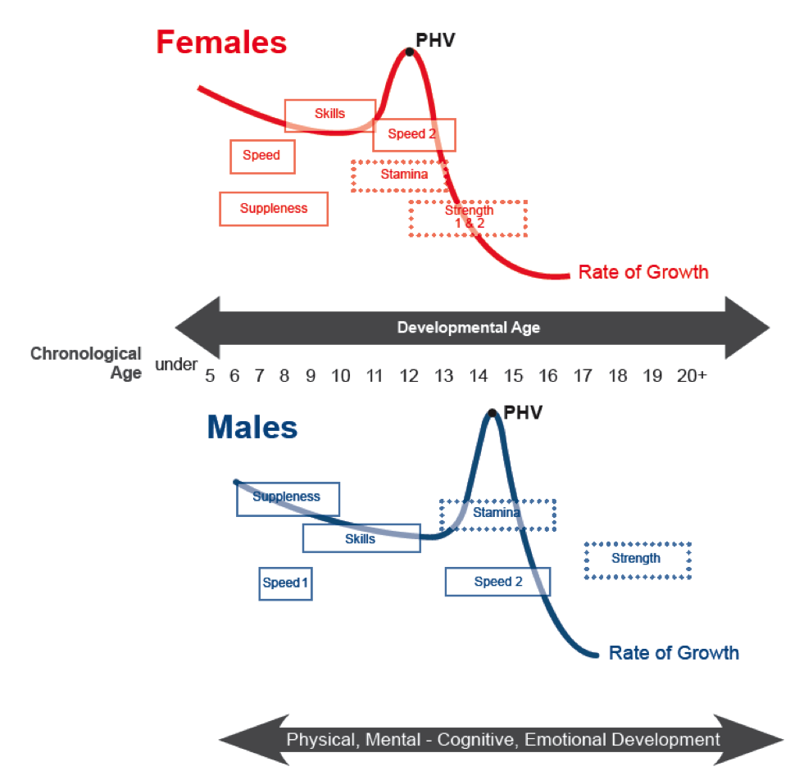

Slide 46
Fundamental Movement Skills
ABC’S5 – Agility, Balance, Coordination, Speed
5S’s – Strength, Speed, Stamina, Suppleness, Skills
SAQ Training & SEC Training
Peak Height Velocity (PHV)
Know the Windows of Athletic Development
Combine Skill & Athletic Development
Every Skill Includes Fundamental Movements

Slide 47
The Concept of FLOW
All Coaches Yearn for FLOW
Effective FLOW Technique
1-2-3-4-5
1 = Run Our Regular Stuff – Players to Decide Actions (SG & DG)
2 = 2nd Side Series – Must Reverse the Ball (KPI)
3 = Screen – two E’s in Three, two E’s in Screen (more Picks)
4 = 4 Down Iso – Best 1on1 Player on Top, Other 4 on Baseline
5 = Drive – 5 Rhymes with Drive – Attack the Rim/Paint

Slide 48
Defensive Considerations
10 Commandments of Defense (Hand Out)
Defense to be Committed to Solving Problems
Preventer, Fixer, Eraser
3 Defensive Priorities
Protect the Rim 2) Pressure the Ball 3) Guard 1.5
1) Disruptive 2) Deceptive 3) Deflective
Pressure the Ball with D21 or D9
7 Angles x 3 Distances = 21 ways to Pressure the Ball (D21)
3 Angles x 3 Distances = 9 ways to send the ball to a Weak Hand (D9)

Slide 49
Defensive Considerations
10 Commandments of Defense (Player Hand Out)
Defense to be Committed to Solving Problems
Preventer, Fixer, Eraser
3 Defensive Priorities
Protect the Rim 2) Pressure the Ball 3) Guard 1.5
1) Disruptive 2) Deceptive 3) Deflective
Pressure the Ball with D21 or D9
7 Angles x 3 Distances = 21 ways to Pressure the Ball (D21)
3 Angles x 3 Distances = 9 ways to send the ball to a Weak Hand (D9)

Slide 50
Defensive Considerations
10 Commandments of Defense (Hand Out)
Defense to be Committed to Solving Problems
Preventer, Fixer, Eraser
3 Defensive Priorities
Protect the Rim 2) Pressure the Ball 3) Guard 1.5
1) Disruptive 2) Deceptive 3) Deflective
Pressure the Ball with D21 or D9
7 Angles x 3 Distances = 21 ways to Pressure the Ball (D21)
3 Angles x 3 Distances = 9 ways to send the ball to a Weak Hand (D9)

Slide 51
Defensive Considerations
10 Commandments of Defense (Hand Out)
Defense to be Committed to Solving Problems
Preventer, Fixer, Eraser
3 Defensive Priorities
Protect the Rim 2) Pressure the Ball 3) Guard 1.5 1) Disruptive 2) Deceptive 3) Deflective
Pressure the Ball with D21 or D9
7 Angles x 3 Distances = 21 ways to Pressure the Ball (D21)
3 Angles x 3 Distances = 9 ways to send the ball to a Weak Hand (D9)

Slide 52
Ball Pressure Actions

Slide 53
Style of Play Coach Education
THANK YOU!
markjonhogan@gmail.com
Mark Hogan, ChPC

Slide 54
Style of Play Coach Education
OVERTIME
BONUS MATERIALS

Slide 55
MISTAKES
are
Expected
Respected
Inspected

Slide 56
Think Before You Speak
WAIT
What Am I Thinking?

Slide 57
The Journey of 1,000 miles
begins with the first step.
ALL STEPS COUNT!

Slide 58
Team Culture
Canada Basketball
REPing
Reminders * Encouragement * Praise

Slide 59
Every Practice Needs a Little
T L C
Teaching
Learning
Competition

